Slide 1
A Case Study Analysis on Cybercrime

Slide 2
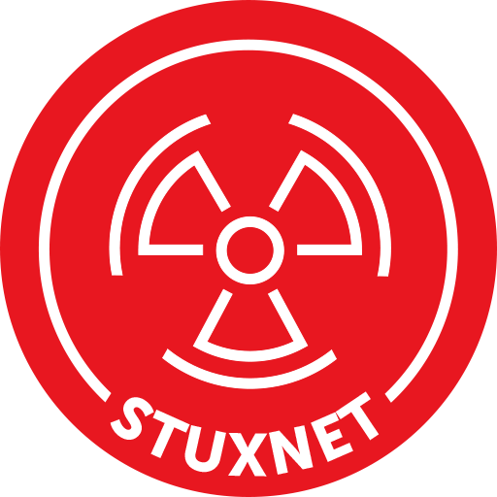
Chosen Country Detail
Chosen Country: Iran
Reason:
This country was chosen because it was the first to confront the first dangerous virus, which causes the physical damage of vulnerable gadget or devices.
Iranian nuclear program was attacked by a formidable force.

Slide 3
Stuxnet
Reasons:
The most sophisticated malicious software that has ever been observed in public.
Uses up to 6 different exploitable vulnerabilities.
Has 3 Root kits.
Infect SCADA Systems.
The first piece of malicious software that could deliver a physical payload.
Notes:
Stuxnet was the most powerful and sophisticated malware which have ever seen which was Developed in June 2009 and spreading began late 2009/early 2010. Discovered in July 2010 in Microsoft out-of-band patch released August 2010.
It's one goal was to destroy the Iranian nuclear program which was Developed by the United States and Israel.
Stuxnet uses 6 vulnerabilities (5 is in Win and the 1 is in Siemens). The total size of file is 1.5MB which is written in C, C++, and other object-oriented languages.
It has three rootkits which are user-mode, Kernel mode and PLC rootkit.
It spread via USB Flash Memory and network shares. It updates itself via internet by connecting HTTP to two websites (encrypted connection)
It was the first ever malware that has a physical payload.

Slide 4
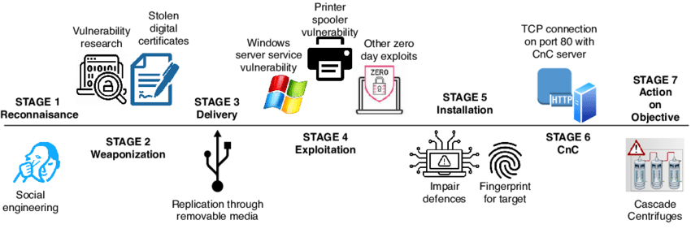
Stuxnet Description
Description:
The Stuxnet worm was explicitly built and distributed by a government with the intention of attacking the Bushehr nuclear power plant in Iran [1]. The United States and Israel are the most common suspects in this case.
Malware that was able to infiltrate systems running WinCC and PCS 7 SCADA and spread itself across networks.
Seized the opportunity presented by the fact that PLCs are typically uninsured.
After getting inside, able to reprograms the PLCs that control the machines.[2].
Notes:
Stuxnet is a malicious computer worm first uncovered in 2010 and thought to have been in development since at least 2005. Stuxnet targets supervisory control and data acquisition (SCADA) systems and is believed to be responsible for causing substantial damage to the nuclear program of Iran. Although neither country has openly admitted responsibility, the worm is widely understood to be a cyberweapon built jointly by the United States and Israel in a collaborative effort known as Operation Olympic Games. T
Stuxnet specifically targets programmable logic controllers (PLCs), which allow the automation of electromechanical processes such as those used to control machinery and industrial processes including gas centrifuges for separating nuclear material. Exploiting four zero-day flaws.
Stuxnet functions by targeting machines using the Microsoft Windows operating system and networks, then seeking out Siemens Step7 software. Stuxnet reportedly compromised Iranian PLCs, collecting information on industrial systems and causing the fast-spinning centrifuges to tear themselves apart.
Stuxnet's design and architecture are not domain-specific and it could be tailored as a platform for attacking modern SCADA and PLC systems.
Malware that spread on networks to infect systems running WinCC and PCS 7 SCADA, Took advantage of the fact that PLCs are usually unsecured
They are behind firewalls and run by other computers that ARE secured, Once inside, had the ability to reprogram PLC controlling machinery
Gave the possibility of altering how machinery being controlled will run [2].

Slide 5
Iran Analysis Against Stuxnet
Nobody has ever seen something even a little bit like that. No one could figure out who might have made such a advanced, complicated and unique piece of malware [3].
In June of 2010, a Belarus-based security firm called as VirusBlokAda [4] discovered that Stuxnet was operating on Iranian systems.
Iran responded to the epidemic by assembling a special squad to combat it.
Since so many computers in Iran are infected with Stuxnet, Iran will need to exercise heightened vigilance to prevent reinfection.
Notes:
At the time, the security world gasped at the sophistication of Stuxnet. No one had ever seen anything like it. Obviously, everyone was wondering who could have been behind such advanced and unprecedented malware, which is perhaps the only one—at least that we know of—to really warrant the definition of "cyberweapon.“
The attack was so well-done that the virus worked undetected for months, and its victims didn't know about it until security companies around the world discovered it and started talking about it.
Stuxnet was discovered on systems in Iran in June 2010 by a security firm from Belarus – VirusBlokAda. It is however believed that it had been released more than a year before that. Stuxnet uses multiple methods and zero-day exploits to spread itself via LANs or USB sticks.
No country has ever claimed or admitted responsibility. But six years later, it's widely assumed that the United States and Israel were the culprits.
In response to the infection, Iran assembled a team to combat it. With more than 30,000 IP addresses affected in Iran, an official said that the infection was fast spreading in Iran and the problem had been compounded by the ability of Stuxnet to mutate. Iran had set up its own systems to clean up infections and had advised against using the Siemens SCADA antivirus since it is suspected that the antivirus contains embedded code which updates Stuxnet instead of removing it.

Slide 6
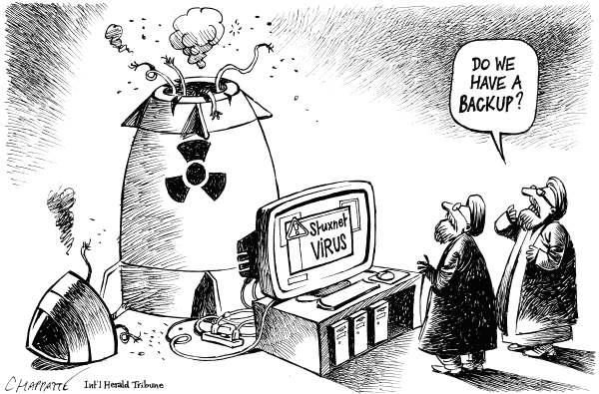
Stuxnet Cost
Cost of making Stuxnet:
It is believed that developing the Stuxnet virus cost one million dollars (about Dh3. 6 million) [5].
Damage due to Stuxnet:
Stuxnet is estimated to have destroyed around one-fifth of Iran's nuclear centrifuges.
The worm successfully infected more than 20,000 machines across 14 Iranian nuclear facilities and destroyed around 900 centrifuges [1].
Notes:
Stuxnet is a malicious computer worm first uncovered in 2010 and thought to have been in development since at least 2005. Stuxnet targets supervisory control and data acquisition (SCADA) systems and is believed to be responsible for causing substantial damage to the nuclear program of Iran. Although neither country has openly admitted responsibility, the worm is widely understood to be a cyberweapon built jointly by the United States and Israel in a collaborative effort known as Operation Olympic Games. T
Stuxnet specifically targets programmable logic controllers (PLCs), which allow the automation of electromechanical processes such as those used to control machinery and industrial processes including gas centrifuges for separating nuclear material. Exploiting four zero-day flaws.
Stuxnet functions by targeting machines using the Microsoft Windows operating system and networks, then seeking out Siemens Step7 software. Stuxnet reportedly compromised Iranian PLCs, collecting information on industrial systems and causing the fast-spinning centrifuges to tear themselves apart.
Stuxnet's design and architecture are not domain-specific and it could be tailored as a platform for attacking modern SCADA and PLC systems.
Malware that spread on networks to infect systems running WinCC and PCS 7 SCADA, Took advantage of the fact that PLCs are usually unsecured
They are behind firewalls and run by other computers that ARE secured, Once inside, had the ability to reprogram PLC controlling machinery
Gave the possibility of altering how machinery being controlled will run

Slide 7
Issues Concerning Crime Investigation
As we discussed earlier that no one had ever seen anything like it.
Also, this was the first ever malware with the physical payloads, no one recognized its impact just saying that it’s a technical issues.
No one is claiming about that specific malware after effecting.
According to history it says that the Iranian engineer was involved in this whole attack. So that’s why it was not an easy to identify the attack where it come from and how it came [6].

Slide 8
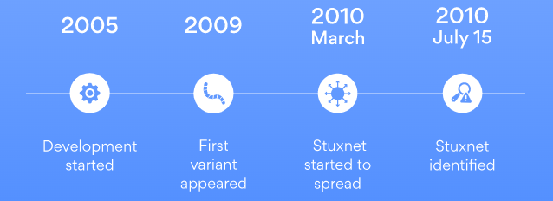
Perception about Stuxnet
Stuxnet has been in development from at least 2005 [7], even though it wasn’t identified or made public until 2010.
In March of 2010, the global spread of the worm began, however the first variant of the worm was detected in 2009.
Stuxnet spread in two waves.
Stuxnet did not inflict considerable damage outside of its original target, but it did serve as a paradigm for later viruses that attacked a variety of infrastructure types and national governments [8].
Notes:
Stuxnet was identified and reported in 2010, although it had been in development since 2005. Stuxnet 0.5 [McD13] is the first known version of Stuxnet. In January 2010, inspectors visiting the Natanz uranium enrichment plant noticed that its centrifuges were failing at an unprecedented rate. They couldn't discover the cause for the failure at that time. After five months, researchers found malicious files in one of the systems [8].
The worm started to spread around March of 2010, but the first variant appeared in 2009. On July 15, 2010 the worm's existence became widely known due to a DDoS attack on an industrial systems security mailing list. This attack interrupted an essential source of information for factories and power plants.
Stuxnet spread in two waves. The first wave was less visible and more targeted than the second. Stuxnet became known to the public during the second wave, which was more aggressive and widespread. The worm managed to infect more than 20,000 devices in 14 Iranian nuclear facilities and ruined around 900 centrifuges.
While Stuxnet didn't do much damage outside its target, it serves as an example for later pieces of malware targeting various infrastructure and nation-states. Modified versions also target non-nuclear facilities.

Slide 9
Perception of Iranian
Many analysts believe that the United States and Israel launched the Stuxnet cyberattack to destroy Iran's nuclear equipment and disrupt a program that they believe is meant to manufacture nuclear weapons [9].
According to Iranian officials, Bushehr staff computers were infiltrated with Stuxnet, although the malware did not cause significant harm [10].
Mohammad Ahmadian, the acting head of Iran's Atomic Energy Organization, indicated that accusations of significant damage to the Bushehr plant were a premeditated attempt by nations opposed to the country's nuclear program, but that they should be investigated nonetheless [11].
According to a senior Iranian official, Iran should investigate allegations that the Stuxnet computer worm has severely damaged the country's first nuclear power station.
Notes:
Many of these discussions raised in the media and world public opinion about the Stuxnet virus are an effort to create concern among the Iranian people and people of the region and delay the work of the nuclear power plant," he told the ISNA news agency. "Therefore it is necessary that experts in the field investigate to see how much truth there is in these discussions.
Many analysts believe Stuxnet was a cyber attack by the US and Israel aimed at disabling Iran's nuclear equipment and slowing down a programme they believe is aimed at making nuclear weapons.
Iranian officials have confirmed Stuxnet hit staff computers at Bushehr but said it did not affect major systems. They deny that they are manufacturing nuclear weapons.

Slide 10
References:
[1] Wikipedia Contributors (2019). Stuxnet. [online] Wikipedia. Available at: https://en.wikipedia.org/wiki/Stuxnet.
[2] CLEMSON, “Stuxnet,” www.clemson.edu. https://www.cs.clemson.edu (accessed Oct. 20, 2022).
[3] L. Franceschi-Bicchierai, “The History of Stuxnet: The World’s First True Cyberweapon,” www.vice.com, 2016. https://www.vice.com/en/article/ezp58m/the-history-of-stuxnet-the-worlds-first-true-cyberweapon-5886b74d80d84e45e7bd22ee.
[4] E. D. Knapp and J. T. Langill, “Stuxnet - an overview | ScienceDirect Topics,” www.sciencedirect.com, 2015. https://www.sciencedirect.com/topics/computer-science/stuxnet#:~:text=Stuxnet%20was%20discovered%20on%20systems (accessed Oct. 20, 2022).
[5] B. Flanagan, “Former CIA chief speaks out on Iran Stuxnet attack,” The National, 2011. https://www.thenationalnews.com/business/former-cia-chief-speaks-out-on-iran-stuxnet-attack-1.392917#:~:text=The%20Stuxnet%20virus%20cost%20an .
[6] “What Is Stuxnet? | Trellix,” www.trellix.com. https://www.trellix.com/en-us/security-awareness/ransomware/what-is-stuxnet.html
[7] J. Fruhlinger, “Stuxnet explained: The first known cyberweapon,” CSO Online, Aug. 31, 2022. https://www.csoonline.com/article/3218104/stuxnet-explained-the-first-known-cyberweapon.html#:~:text=Stuxnet%20was%20first%20identified%20 by (accessed Oct. 20, 2022).
[8] “Stuxnet explained — the worm that went nuclear | NordVPN,” nordvpn.com, Mar. 10, 2022. https://nordvpn.com/blog/stuxnet-virus/
[9] “US and Israel were behind Stuxnet claims researcher,” dhushara.com, 2011. https://www.dhushara.com/Biocrisis/11/apr/stuxnet.pdf
[10] “Iran says it has detected second cyber attack,” Reuters, Apr. 25, 2011. Accessed: Oct. 20, 2022. [Online]. Available: https://www.reuters.com/article/oukin-uk-iran-computer-virus-idUKTRE73O1P720110425
[11] C. Arthur, “Iran should investigate Stuxnet virus, says atomic chief,” the Guardian, Feb. 04, 2011. https://www.theguardian.com/world/2011/feb/04/iran-stuxnet-virus (accessed Oct. 20, 2022).

Slide 11
Thank You

